Slide 1

PROGRESS ON STUDENT EQUITY
Monitoring Santa Ana College’s Progress on the Student Equity and Achievement Metrics

Slide 2

01
Table of Contents
02
03
04
2019-2022 SEA Goals
Overall goals set for metrics in last Student Equity Plan
Calculating Equity Gaps
Review of how gaps are determined
Racially Minoritized Groups
Identification of racial/ethnic groups who experienced gaps in 2019-2022
Progress on Metrics
Trend data for last three years
Goal Setting
05
Before and after

Slide 3
01
2019-2022 SEA GOALS
Goals Set by Santa Ana College in Last Student Equity Plan

Slide 4
Caveat
In March 2021, the definitions were changed for four of the five Student Equity & Achievement metrics which affected the data
Notes:
Changes can be viewed here: https://www.calpassplus.org/CalPassPlus2.0/Media/Launchboard/ssm/Changes%20in%20Definitions_SSM%203.0_Mar%202021.docx

Slide 5
Crosswalk SEA Metrics – Old Methodology (2019-22) vs. New Methodology (2022-25)
Metric | Old | New
Successful Enrollment in First Year | Any student who applied in the selected year who enrolled in the college in same year (300SX) | First-time in college, excludes special admit, credit enrolled (300CX)
Completion of Transfer-Level Math and English in First Year | Any student new to the district who completed transfer-level math and English in first year (501SX) | First-time in college, excludes special admit, credit enrolled (501CX)
Term to Term Retention | Any student who enrolled in the fall who subsequently enrolled in Spring (excluding those who got award or transferred) (406SX) | First-time in college, excludes special admit, credit enrolled (453CX) Not just fall to spring, but spring to fall, too First term counted only
Attained Vision Goal Completion | Any student who earned a degree or certificate in selected year (619SX) | First-time in college, excludes special admit, credit enrolled (619CX) Tracking cohort forward for three-years, no longer snapshot of selected year
Transferred to Four-Year Institution | Any student who transferred to a four-year in selected year, was enrolled in 12+ units in previous year, was not concurrently enrolled in any CCC in selected year (620SX) | First-time in college, excludes special admit, credit enrolled (620CX) Tracking cohort forward for three-years, no longer snapshot of selected year
Notes:
https://www.calpassplus.org/CalPassPlus2.0/Media/Launchboard/ssm/Changes%20in%20Definitions_SSM%203.0_Mar%202021.docx
Changes can be viewed here: https://www.calpassplus.org/CalPassPlus2.0/Media/Launchboard/ssm/Changes%20in%20Definitions_SSM%203.0_Mar%202021.docx

Slide 6
2019-2022 Student Equity Goals
 |  |  | Baseline | Goal | Equity Change
 | Enrolled in Same Community College |  | 22110 | 24321 | +10.00%
 | Transferred to a Four-Year Institution |  | 1991 | 2688 | +35.01%
 | Retained from Fall to Spring at Same College |  | 23972 | 25410 | +6.00%
 | Completed Both Transfer-Level Math and English in First Year |  | 334 | 889 | +116.17%
 | Attained the Vision Goal Completion |  | 1969 | 2501 | +27.02%

Slide 7
02
CALCULATING EQUITY GAPS
A refresher on how gaps are determined for the metrics

Slide 8
Two Methods for Different Metric Types
Percentage Point Gap (PPG)
Proportionality Index (PI)
For metrics describing rates or percentages, subtract the performance of the reference group from the performance of the selected group
For metrics describing volume or numbers of students, divide the proportion of selected group in outcome by the proportion of same group in reference group

Slide 9
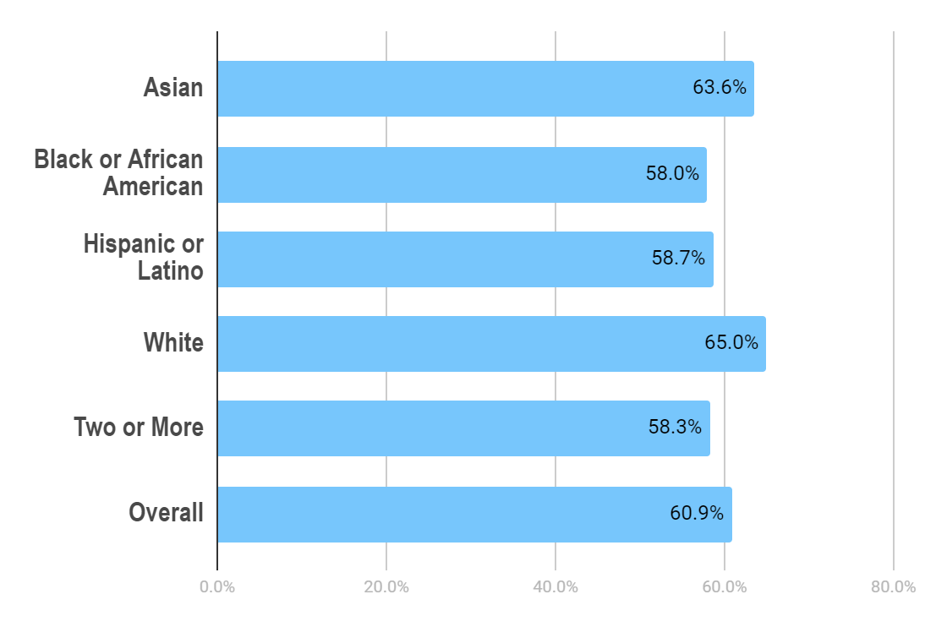
Example PPG: Retained from Fall to Spring
2017-2018
65.0%
Highest Performing Group: White
58.7%
Hispanic or Latino
The percentage of all enrolled students who retained from fall to spring at college in selected year, excluding students who completed an award or transferred to a postsecondary institution

Slide 10
Example PPG: Retained from Fall to Spring
-6.3%
58.7%
65.0%
45K
45K
Hispanic or Latino
Highest Performing Group: White
Percentage Point Gap
(Equity Gap)
Negative ppg values indicate that the selected group is experiencing disparate outcomes for the metric

Slide 11
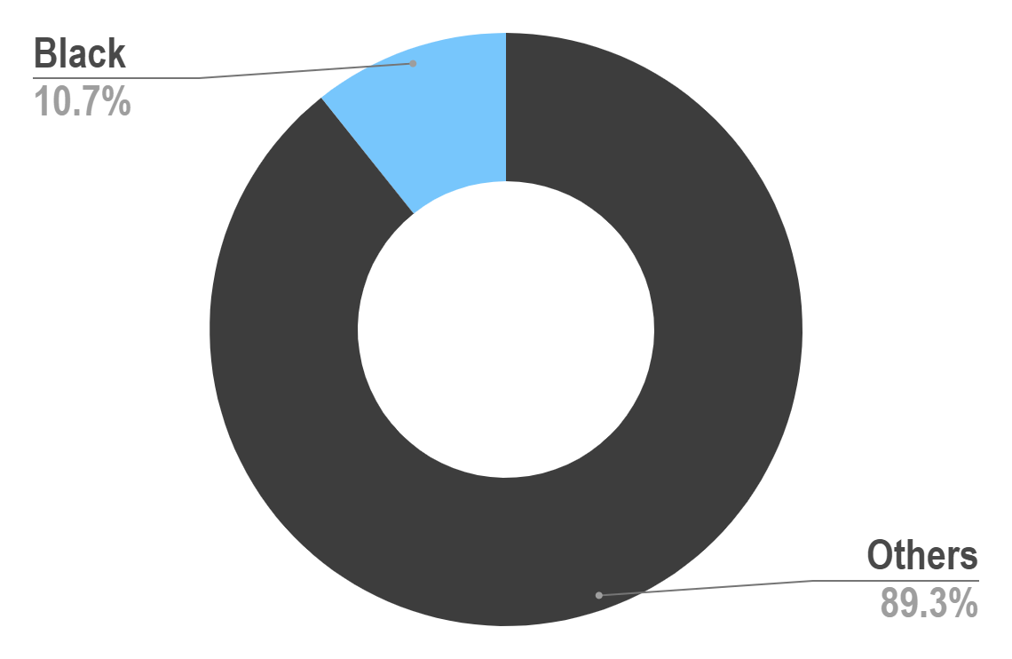
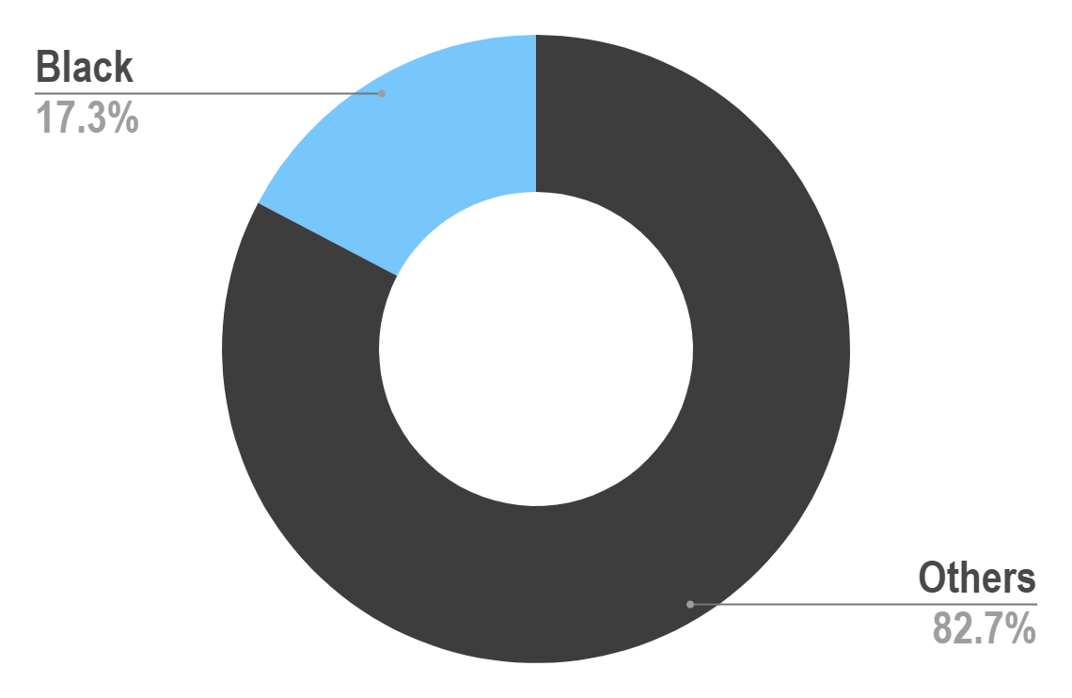
Example PI: Vision Goal Completion
Vision Goal Completers, 2017-2018
Degree/Transfer Student Journey, 2017-2018

Slide 12
Example PI: Vision Goal Completion
10.7%
17.3%
0.62
% of vision goal completers
who are Black
% of reference group
who are Black
Proportionality Index
Values less than 1.0 indicate the selected group is experiencing disparate outcomes for the metric

Slide 13
03
RACIALLY MINORITIZED GROUPS
Which groups experienced equity gaps in the
baseline year?

Slide 14
Who were the Highest Performing Groups*? 2017-2018
Enrolled in the Same College
Retained from Fall to Spring
Completed Transfer English & Math
Hispanic or Latino
Filipino*
Hispanic or Latino
*N>100

Slide 15
Which Groups* Experienced the Largest Equity Gaps (Baseline Year 2017-2018)**?
 |  |  | Group | Equity Gap
 | Enrolled in Same Community College |  | Black or African American | -14.3% PPG
 |  |  | Filipino | -15.8% PPG
 | Transferred to a Four-Year Institution (2016-2017 baseline) |  | Hispanic or Latino | 0.85 PI
 | Retained from Fall to Spring at Same College |  | Black or African American | -6.6% PPG
 | Completed Transfer-Level Math & English |  | Asian | -1.7% PPG
 | Attained the Vision Goal Completion |  | Black or African American | 0.63 PI
*Racially minoritized group; **N>100

Slide 16
04
PROGRESS ON METRICS
Reflect on the last three years: where has your college improved? Which metrics need more attention?

Slide 17
Overall Trends
Santa Ana College:
Improved on 3 of 5 metrics
Met or exceeded goal on 0 of 5 metrics
% Change from Most Recent Year’s Performance to Baseline Year Performance (2017-2018)*
*2016-2017 used for transfer

Slide 18
Equity Trends Over Last Three Years (1/3)
Black or African American students experienced one of the largest equity gaps for three of the five metrics in the baseline year
Santa Ana College reduced gaps produced for Black/African American students on one of the three metrics…

Slide 19
Equity Trends Over Last Three Years (2/3)
… but widened equity gaps for Black or African American students on the other two metrics

Slide 20
Equity Trends Over Last Three Years (3/3)
SAC slightly reduced gaps for Filipino students on the enroll metric
SAC slightly reduced gaps for Asian students on the English/math metric
Equity gap for Hispanic or Latino students stayed the same for the transfer metric

Slide 21
05
GOAL SETTING
BEFORE and AFTER

Slide 22
TIME TRAVEL TO 2016-17
 | 2014-15 | 2015-16 | 2016-17 | SD | 2017-2018 Goal | 2017-18
Enrolled | 11532 | 11078 | 10214 | 670 | 10884 | 9480
Transferred | 1810 | 2025 | 1924 | 108 | 2032 | 1898
Retained | 22795 | 20409 | 20409 | 1378 | 21787 | 17984
Completed ENGL/Math | 335 | 358 | 374 | 20 | 394 | 434
Completed Vision Goal | 1710 | 1901 | 1859 | 100 | 1959 | 1983
SANTA ANA COLLEGE:
Met or exceeded goal on 2 of 5 metrics

Slide 23
TIME TRAVEL TO 2017-18
 | 2014-15 | 2015-16 | 2016-17 | 2017-18 | SD | 2018-19 Goal | 2018-19
Enrolled | 11532 | 11078 | 10214 | 9480 | 913 | 10393 | 10496
Transferred | 1810 | 2025 | 1924 | 1898 | 88 | 1986 | 2041
Retained | 22795 | 20409 | 20409 | 17984 | 1964 | 19948 | 20821
Completed ENGL/Math | 335 | 358 | 374 | 434 | 42 | 476 | 473
Completed Vision Goal | 1710 | 1901 | 1859 | 1983 | 114 | 2097 | 2080
SANTA ANA COLLEGE:
Met or exceeded goal on 3 of 5 metrics

Slide 24
TIME TRAVEL TO 2018-19
 | 2014-15 | 2015-16 | 2016-17 | 2017-18 | 2018-19 | SD | 2019-20 GOAL | 2019-20
Enrolled | 11532 | 11078 | 10214 | 9480 | 10496 | 791 | 11287 | 9526
Transferred | 1810 | 2025 | 1924 | 1898 | 2041 | 95 | 2136 | n/a
Retained | 22795 | 20409 | 20409 | 17984 | 20821 | 1711 | 22532 | 16206
Completed ENGL/Math | 335 | 358 | 374 | 434 | 473 | 57 | 530 | 546
Completed Vision Goal | 1710 | 1901 | 1859 | 1983 | 2080 | 139 | 2219 | 2224
SANTA ANA COLLEGE:
Met or exceeded goal on 2 of 5 metrics

Slide 25
Setting Goals Transfers to Four-Year Institutions
OLD GOAL
“NEW” GOAL
2126 (2041+SD)
2019-20

Slide 26

Sample Reflection Questions:
What do the historical trends tell us about how well we have been addressing racial equity in the last three years?
What else do we need to know to deepen our understanding of the data trends or determine what actions we need to take?
Do the data surprise you or align with your personal experiences?
What current policies, practices, etc. need further attention as we begin planning for the next Student Equity Plan?

